Slide 1


PROJECT: QoT estimation in optical networks
GROUP H
Fiore Mattia 10940788
Lobaccaro Pasquale 10958708
Revelo Samaniego Pablo Eduardo 10933556

Slide 2
Background
Optical signals are often evaluated using a Quality of Transmission (QoT) metric, such as the Signal-to-Noise Ratio (SNR), and the Modulation Format (MF) is configured based on the SNR.
During network planning, we must select the appropriate MFs before transmitting the signal through the network and measuring the SNR. Otherwise, overestimated MFs lead to disruption of the signals, and understimated MFs cause an inefficient use of the resources.
We also need to choose between multiple potential paths for the signal, as the SNR varies across different paths due to differences in the number of optical amplifiers and the presence of interfering channels.

Slide 3
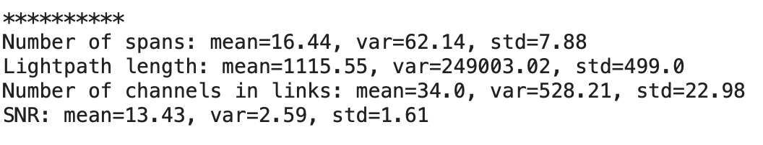
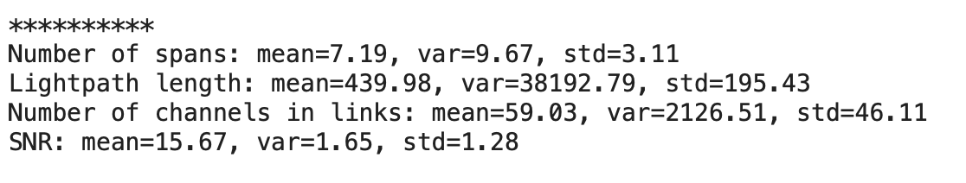
Dataset
Two datasets were provided: 21-node European and 17-node German networks. They were analyzed separately, starting with the European dataset.
Each row of the dataset has a list of the Lengths of all the spans in [km], a list of the Number of channels of the links across the light path, and the value of the SNR measured in [dB].
With the function read_dataset(filename) we get these features on separate lists.
Then, with the funcion calculate_m_v_s(spans, link_occ, snr_values)we get a brief summary of the caracterisitcs of the dataset.
We can see that the two datasets have very different distribution of values on distances and number of spans.
European Nodes
German Nodes

Slide 4
Feature Extraction
Now we define the function X = extract_features(spans, link_occ)
to fill the X matrix with the corresponding features of the path.
The features for each lightpath will be (columns):
Number of Fiber Spans
Overall Length
The Lenght of the Longest Span
Number of Links
The total number of channels on all the links
Maximum Number of channels on a link
To see the features of each dataset we created plots of every feature of the X matrix.
We now plot the features to try to find a relationship between their values and the SNR obtained.

Slide 5
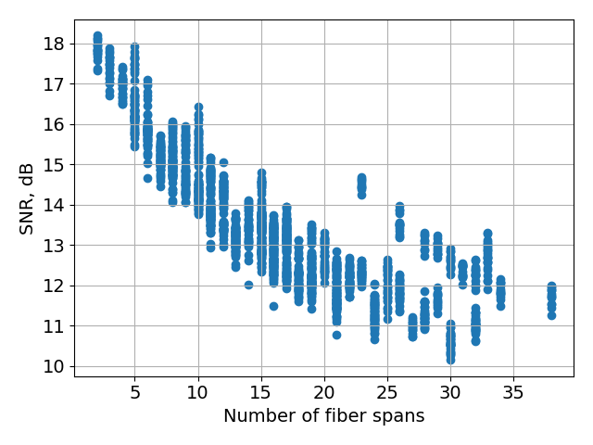
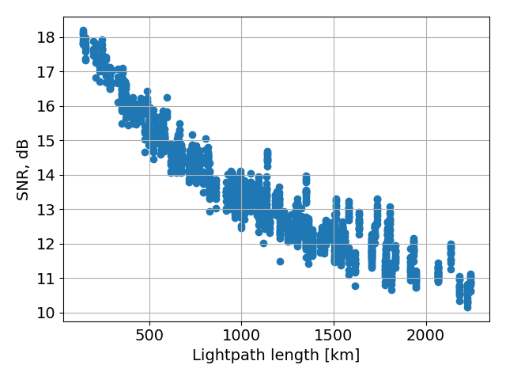
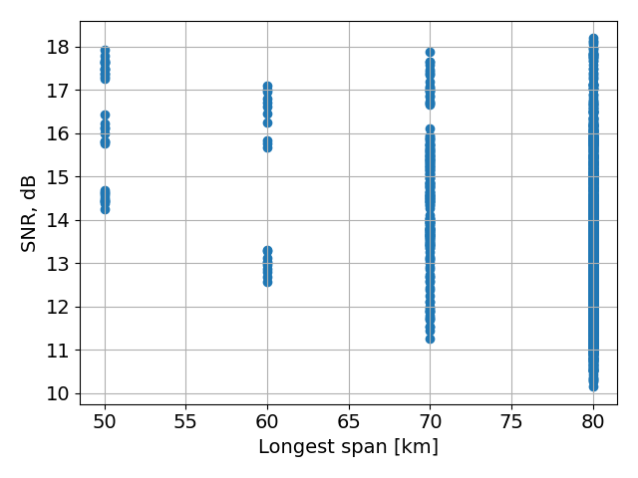
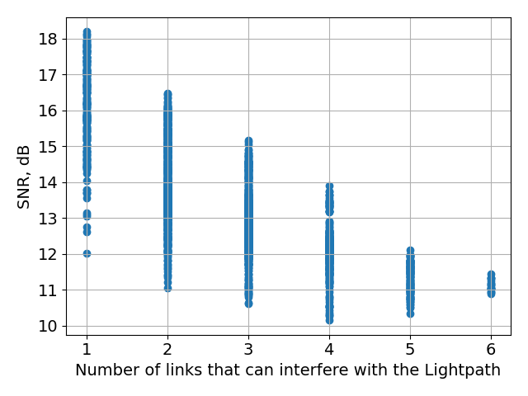
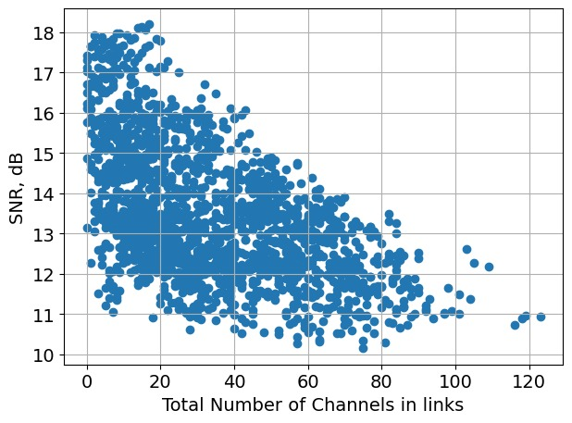
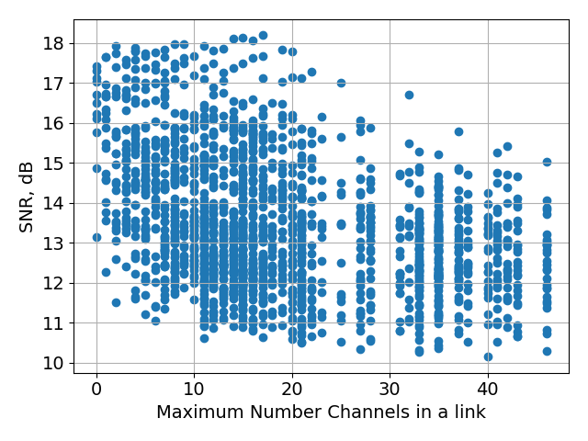
EUROPEAN NODES

Slide 6
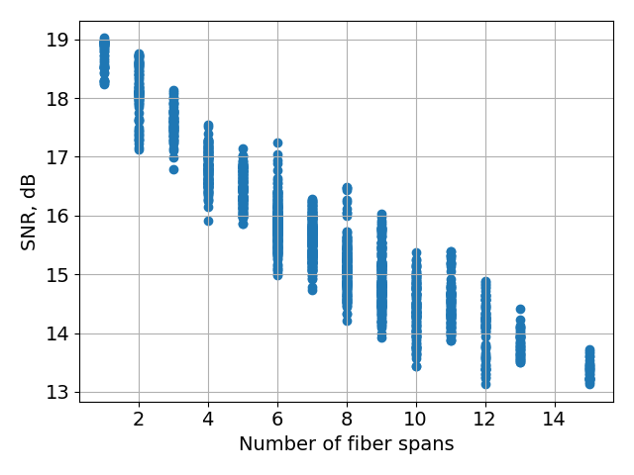
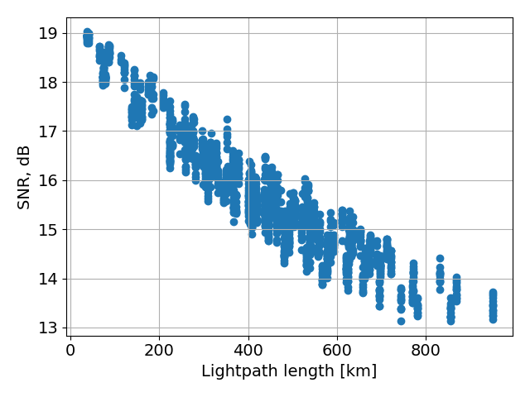
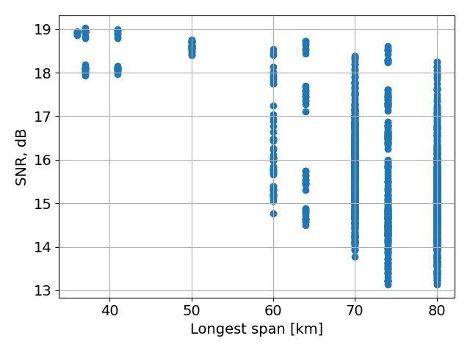
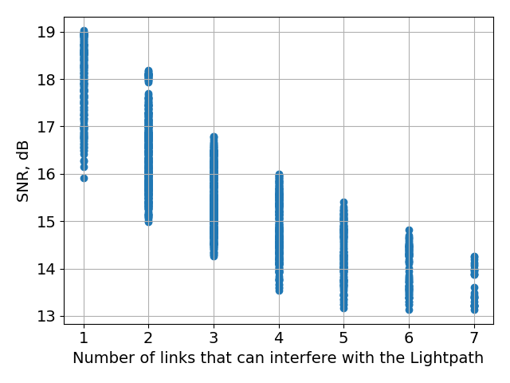
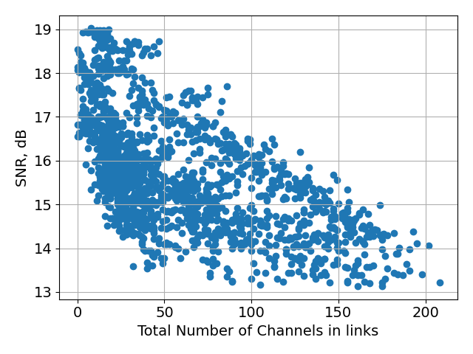
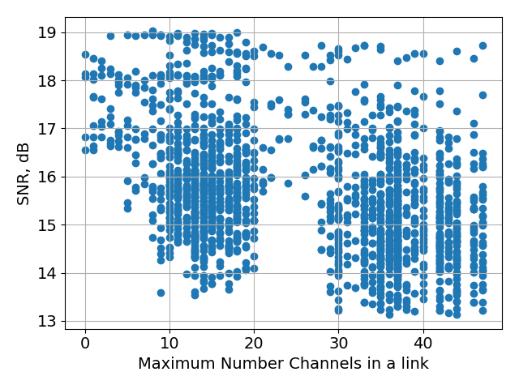
GERMAN NODES

Slide 7
Observations
It can be seen that the "Lightpath Length", the "Number of spans“ are features that are inversely proportional with respect to the SNR of the link.
The "Total Number of channels in links" also follow this relation, but not as strong as the previous two features mentioned.
The other features don't give a strong or clear relationship with respect to the value of the SNR.

Slide 8
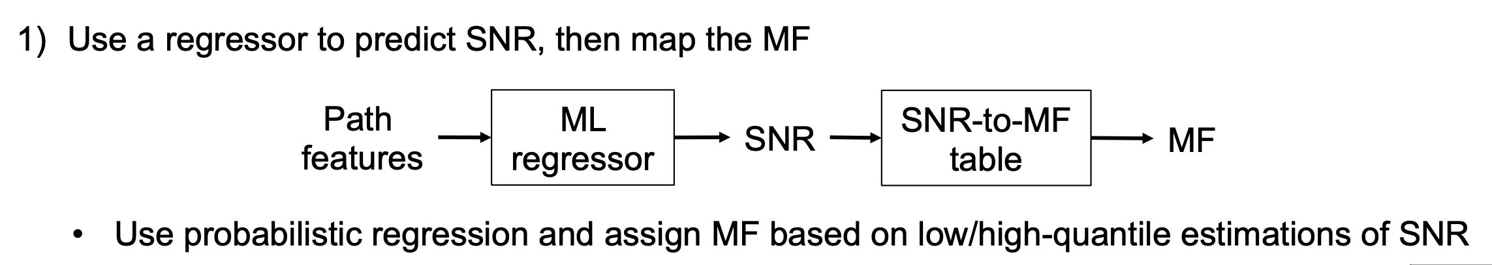
LGBM as regressor with quantile regression
LightGBM (Light Gradient Boosting Machine) is a highly efficient, distributed, and high-performance gradient boosting framework based on decision tree algorithms. It is designed to be faster and more efficient than other gradient boosting frameworks like XGBoost. LightGBM is particularly suited for large datasets and has several unique features that contribute to its performance advantages, it allows quantile regression.
Probabilistic regression is a type of regression analysis that predicts a distribution of possible outcomes rather than a single point estimate. This approach allows us to quantify the uncertainty in our predictions, which can be very useful in many applications.
Quantile regression is a method of probabilistic regression. Instead of predicting the mean (as in ordinary least squares regression), quantile regression predicts a specified quantile of the response variable. For example, the 10th percentile (0.1 quantile) and the 90th percentile (0.9 quantile).

Slide 9
LGBM as regressor with quantile regression
LightGBM can be configured to predict quantiles using the objective parameter set to quantile.
In order to properly evaluate the performance of the ML algorithm, we will split the dataset into training and testing. Then, we'll find the best parameters on the training using crossvalidation.
- Training set: 80%
- Testing set: 20%
- Cross-validation 5 fold (only for hyperparameter optimization)
We evaluated performance with and without hyperparameters optimization.
Using quantile regresion we calculated the SNR values of both low and high quantiles, and averaged them to get the final SNR values.
Then we also did the conversion from SNR to MF, and presented the number of incorrect matches.
We calculated some performance metrics of the regressor.

Slide 10
Without Hyperparameters optimization
European
Training Duration: 0.15 seconds
Mean Squared Error: 0.06
Mean Absolute Error: 0.19
Accuracy: 0.93
Precision: 0.93
Recall: 0.93
F1-score: 0.93
Number of incorrectly-assigned MFs: 26
Number of overrated MFs: 12
Number of underrated MFs: 14
German Training Duration: 0.16 seconds
Mean Squared Error: 0.04
Mean Absolute Error: 0.15
Accuracy: 0.95
Precision: 0.95
Recall: 0.95
F1-score: 0.95
Number of incorrectly-assigned MFs: 17
Number of overrated MFs: 8
Number of underrated MFs: 9

Slide 11
With Hyperparameters optimization
European
Training Duration: 0.20 seconds
Mean Squared Error: 0.06
Mean Absolute Error: 0.18
Accuracy: 0.94
Precision: 0.94
Recall: 0.94
F1-score: 0.94
Number of incorrectly-assigned MFs: 22
Number of overrated MFs: 12
Number of underrated MFs: 10
German
Training Duration: 0.21 seconds
Mean Squared Error: 0.04
Mean Absolute Error: 0.15
Accuracy: 0.96
Precision: 0.96
Recall: 0.96
F1-score: 0.96
Number of incorrectly-assigned MFs: 14
Number of overrated MFs: 5
Number of underrated MFs: 9

Slide 12
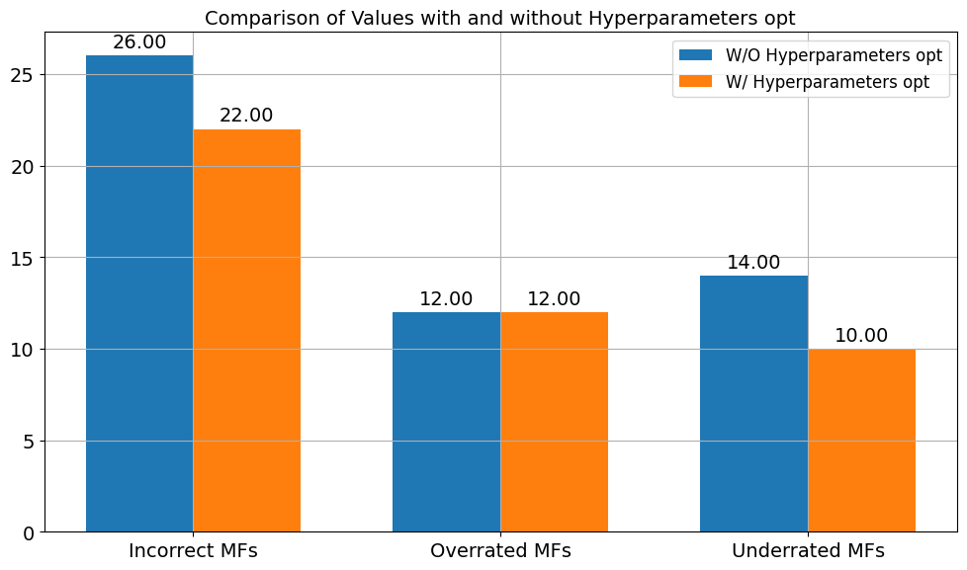
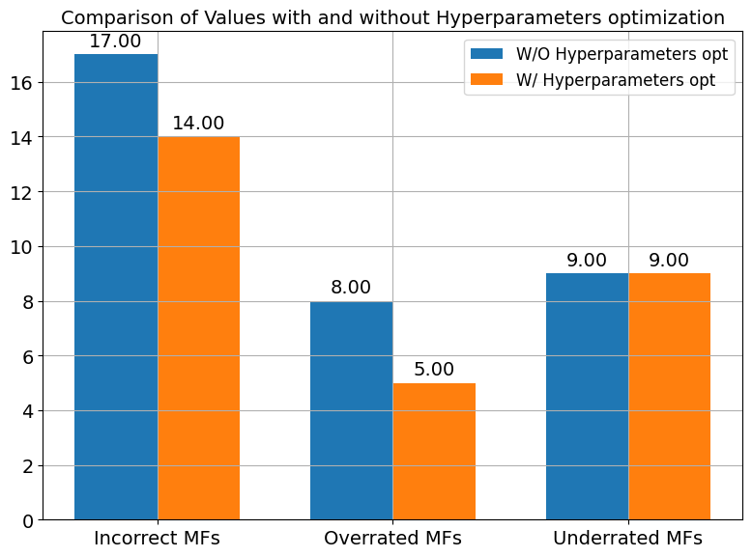
Results
European
German

Slide 13
Simpler Models
To establish the performance of the LGBM method we compared it with: Linear Regression and K-Nearest Neighbor.
For KNN algorithm, since it is based on distances, we used the min max scaler for normalizing the data. Normalization can improve the performance and accuracy of the KNN model. When features are on similar scales, distance calculations better reflect the true differences between data points. This can lead to more accurate predictions, as the most relevant neighbors are considered. So here we considered also the normalized case

Slide 14
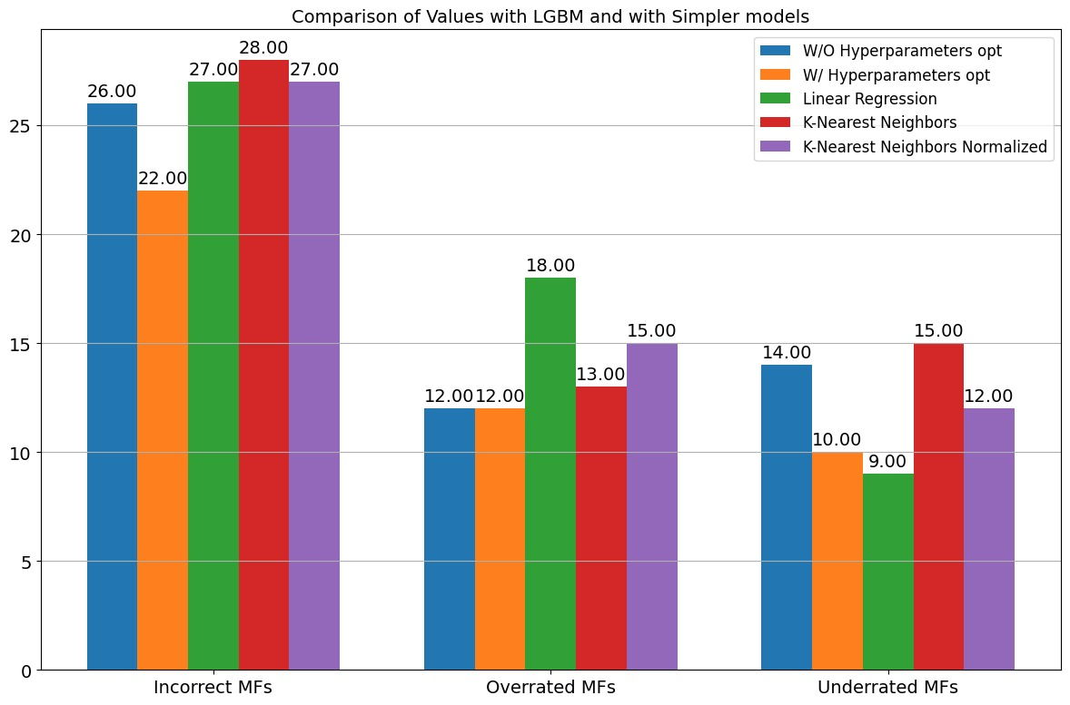
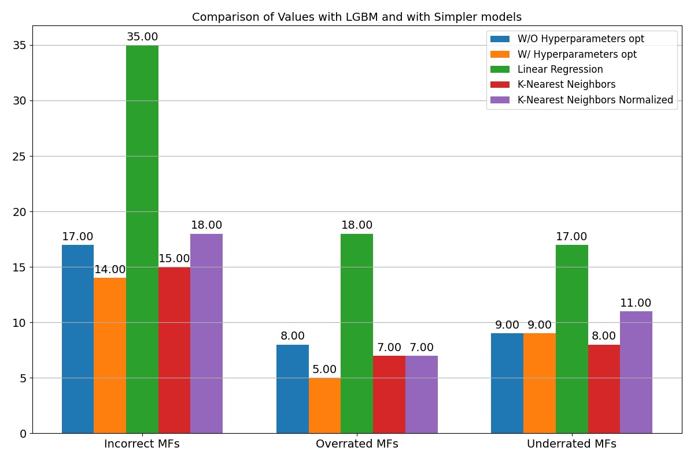
Models comparison
European
German

Slide 15
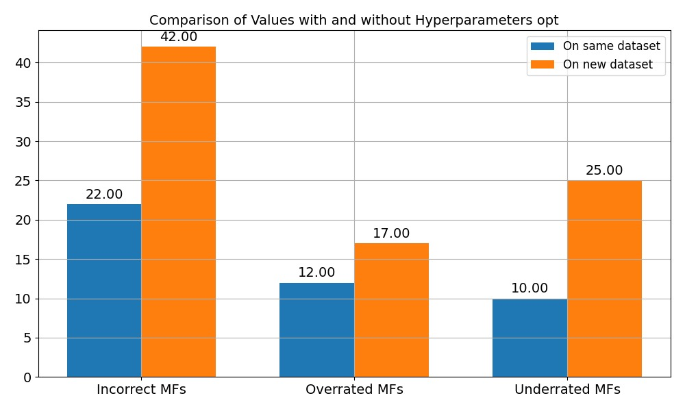
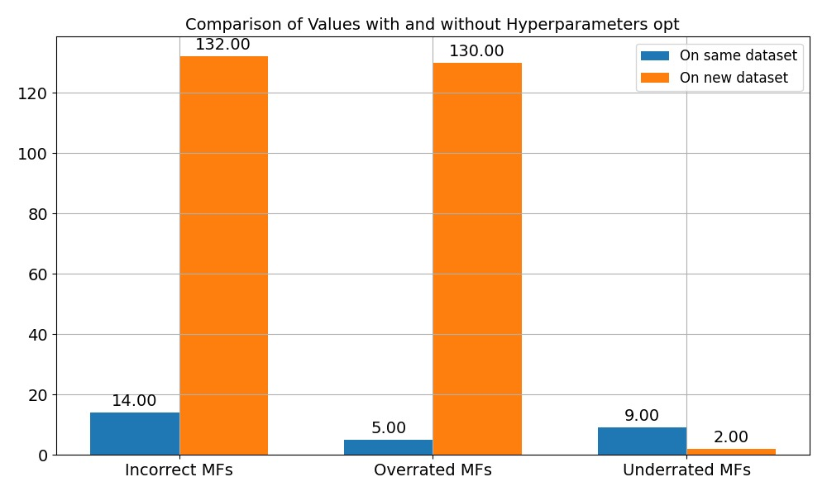
Testing the datasets
European predicting German
German predicting European

Slide 16
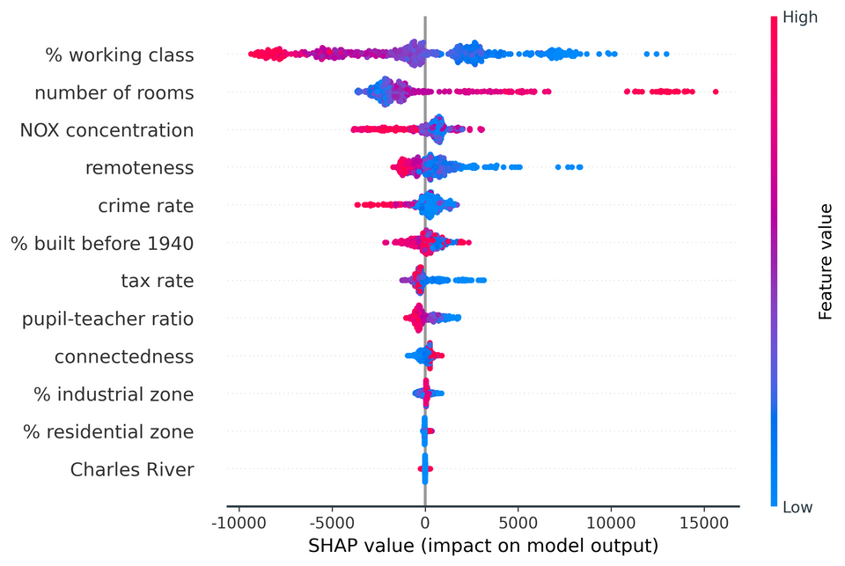

eXplainable AI
We saw the relationship between the features using XAI to make sure that the model takes correct decisions based on correct reasons.
We start obtaining the shap values for the LGBM regressors for high and low quantile, and get the mean of these results.
For this method, as we use LGBM only as a regressor, we can only plot the Global summary of the SNR values predicted, because the MFs are later mapped with the corresponding conversion, which is no longer attached with the LGBM.

Slide 17
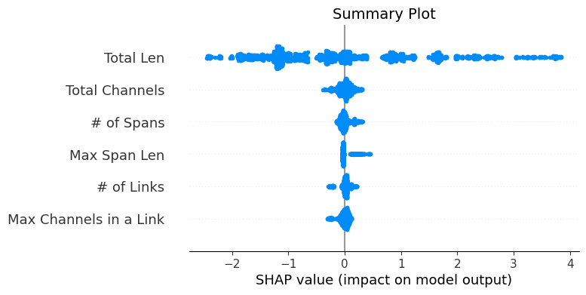
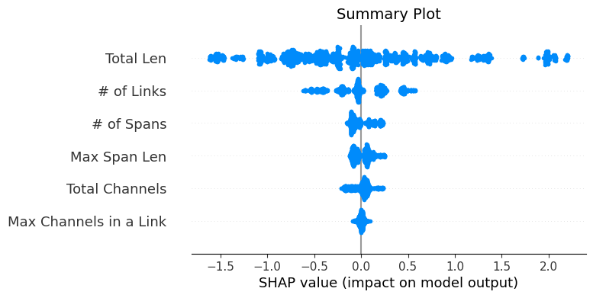
eXplainable AI
The value of the predicted SNR depends very highly on the feature "Total Len” for both the Datasets.
For the European dataset the second and third more impactful features were "Total Channels" (means some interference on the lighpath) and the “Number of Spans" (means the introduction of more Optical Amplifiers that introduce more AES noise that degrades the SNR).
For the German the second more impactful feature was “Number of links ”

Slide 18
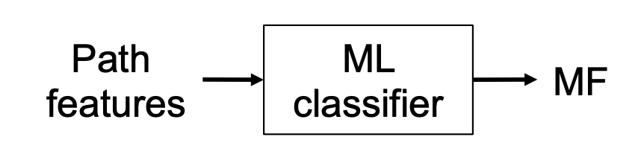
LGBM as Classifier
In this section we used LGBM directly as a classifier instead of going through the quantile regression procedure.
The approach to the dataset was the same of the previous case with train_test_split and crossvalidation. Also in this case we compared the result of the technique with and without Hyperparameters optimization.
European
Accuracy: 0.93 Precision: 0.93
Recall: 0.93
F1-score: 0.93
Number of incorrectly-assigned MFs: 24
Number of overrated MFs: 11
Number of underrated MFs: 13

Slide 19
Without Hyperparameters optimization
European
Training Duration: 0.49 seconds
Mean Squared Error: 2.27
Mean Absolute Error: 0.37
Accuracy: 0.93
Precision: 0.93
Recall: 0.93
F1-score: 0.93
Number of incorrectly-assigned MFs: 25 Number of overrated MFs: 10 Number of underrated MFs: 15
German
Training Duration: 0.51 seconds
Mean Squared Error: 20.25
Mean Absolute Error: 0.72
Accuracy: 0.96
Precision: 0.96
Recall: 0.96
F1-score: 0.96
Number of incorrectly-assigned MFs: 15 Number of overrated MFs: 8
Number of underrated MFs: 7

Slide 20
With Hyperparameters optimization
European
Accuracy: 0.93
Precision: 0.93
Recall: 0.93
F1-score: 0.93
Number of incorrectly-assigned MFs: 24
Number of overrated MFs: 11
Number of underrated MFs: 13
German
Accuracy: 0.97
Precision: 0.96
Recall: 0.97
F1-score: 0.97
Number of incorrectly-assigned MFs: 11 Number of overrated MFs: 6
Number of underrated MFs: 5

Slide 21
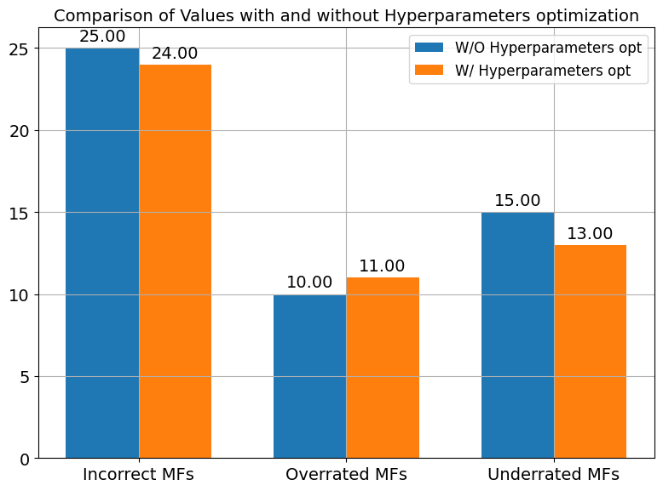
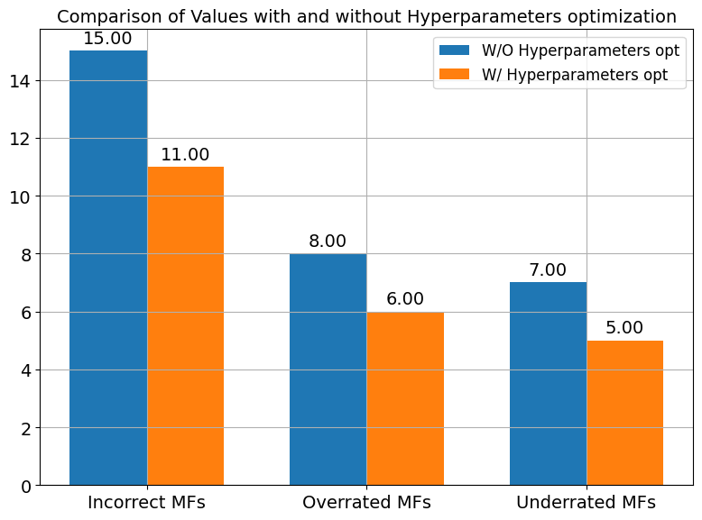
Results
European
German

Slide 22
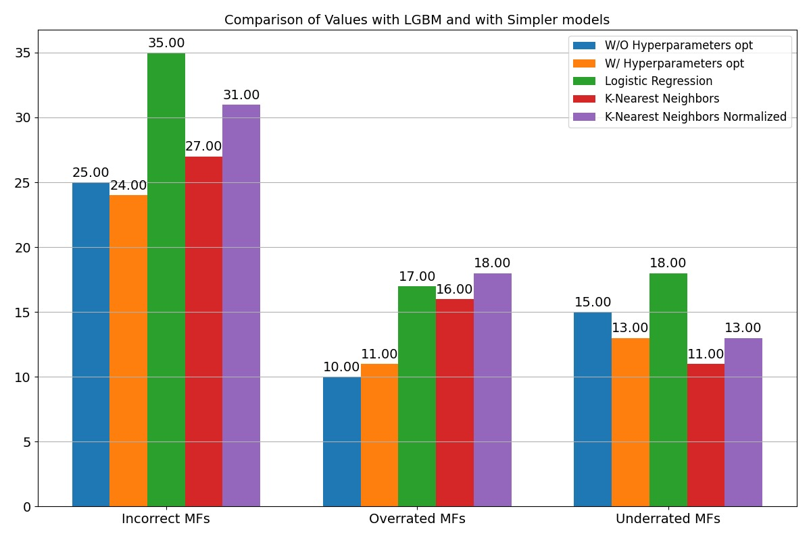
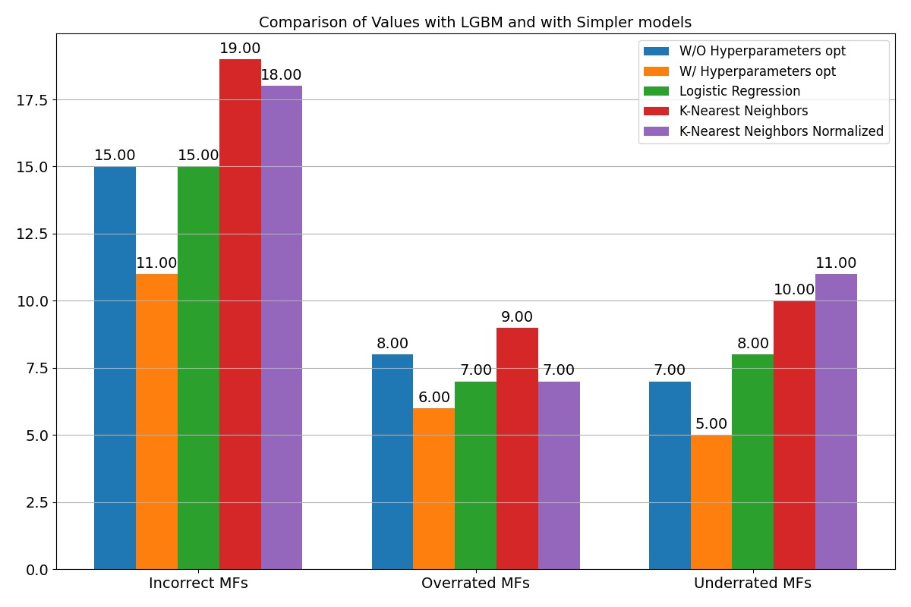
Models comparison
In this section we used the LogisticRegression and KNeighborsClassifier.
With these graphs we can conclude that, indeed, the LGBM with hyperparameters is an excellent choice as a classifier for our model.
European
German
European

Slide 23
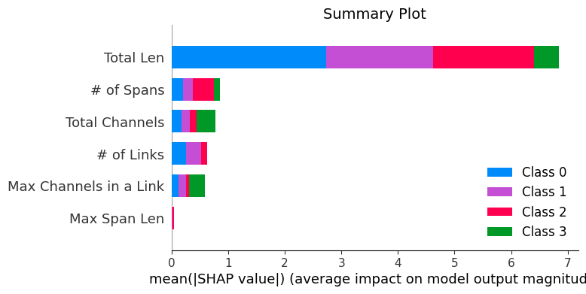
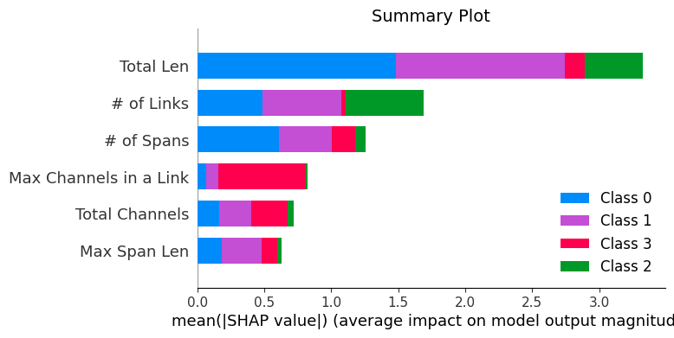
eXplainable AI
We show first the plot of all the predicted MFs, and the overall relationship of the prediction with the features of the lightpath. Now, as we use LGBM as a classifier, we can show the various types of MFs and not only raw SNR values.
For this method we posses different MFs (classes) predicted, which allows us to create summary plots of the influence of the lightpath features on each of the MF selected.
European
German

Slide 24
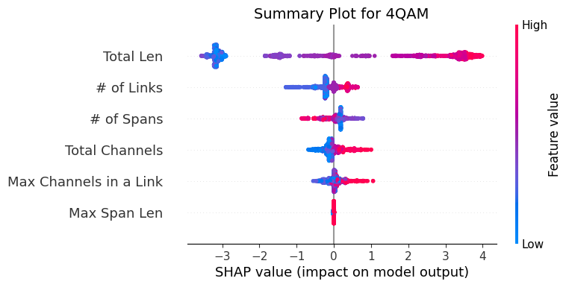
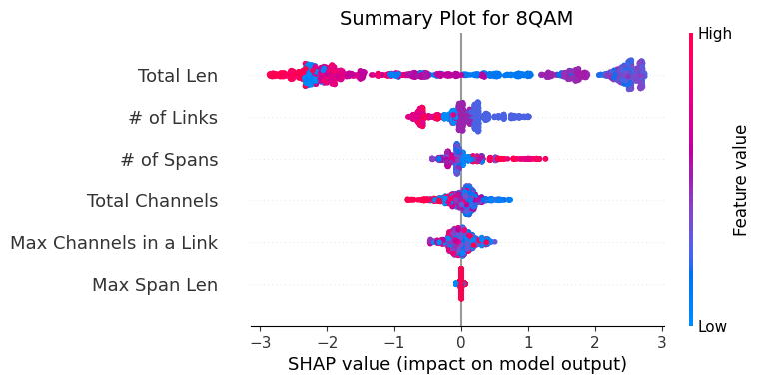
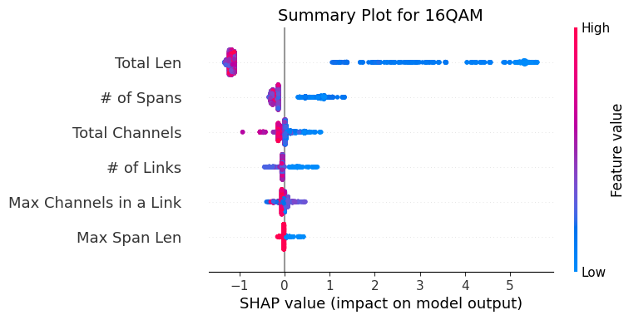
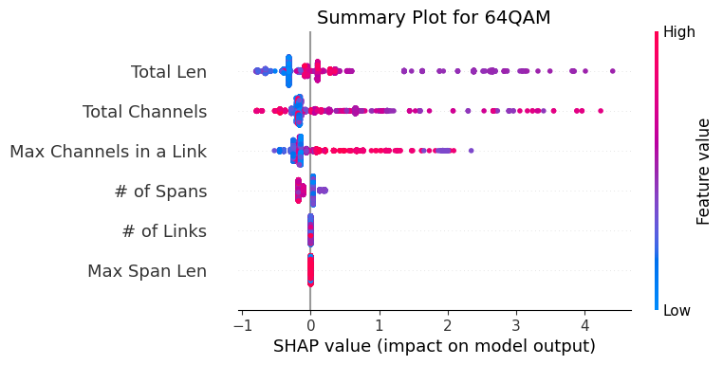
eXplainable AI European

Slide 25
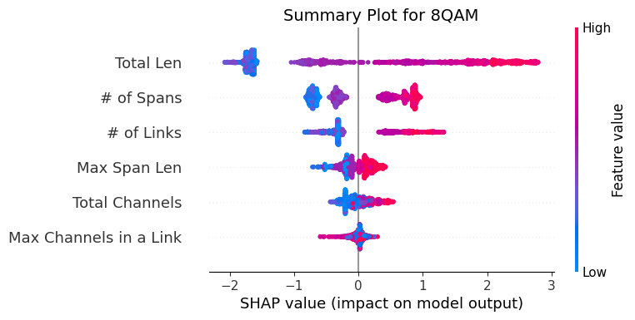
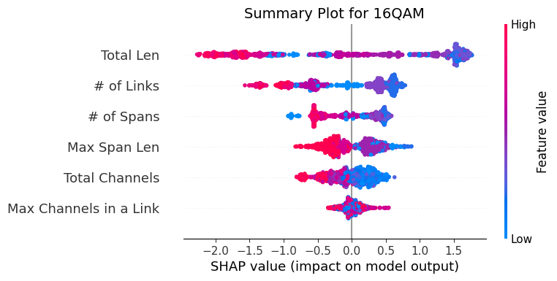
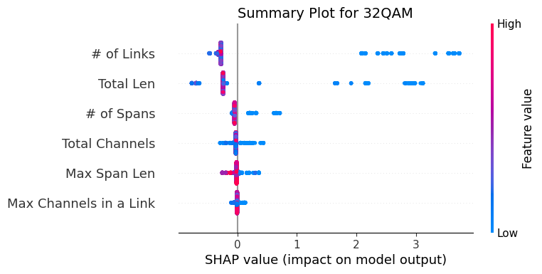
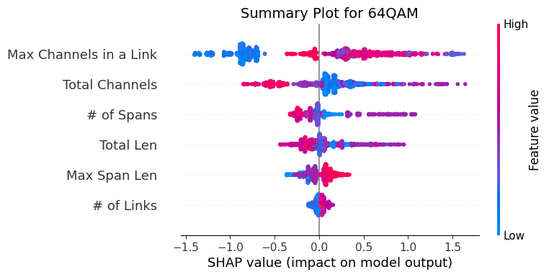
eXplainable AI German

Slide 26
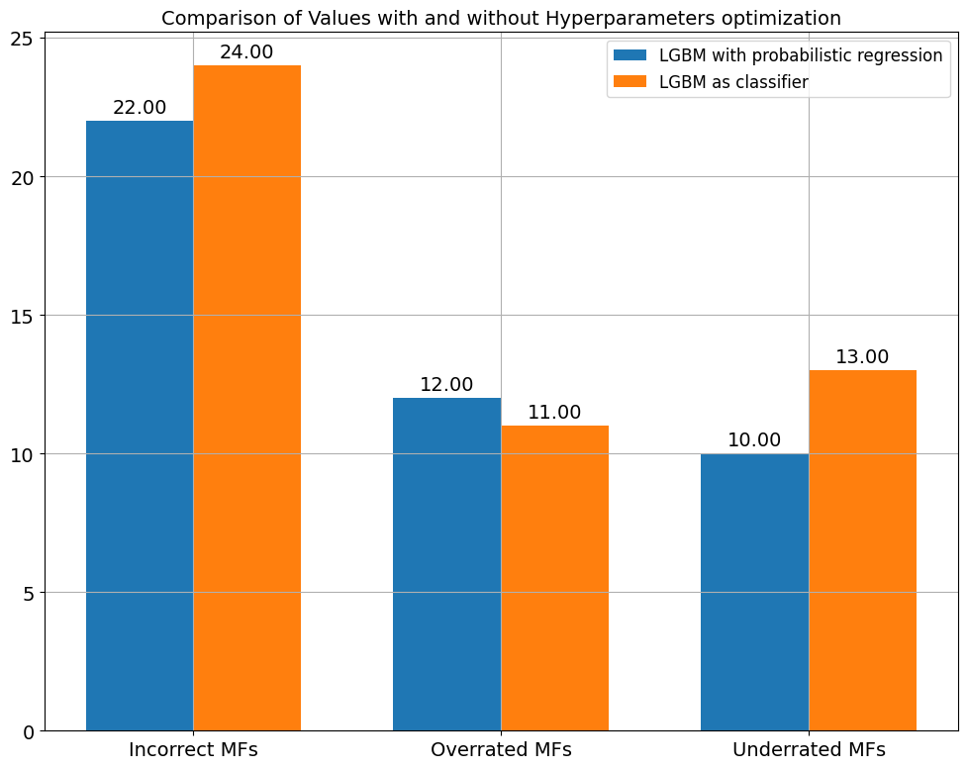
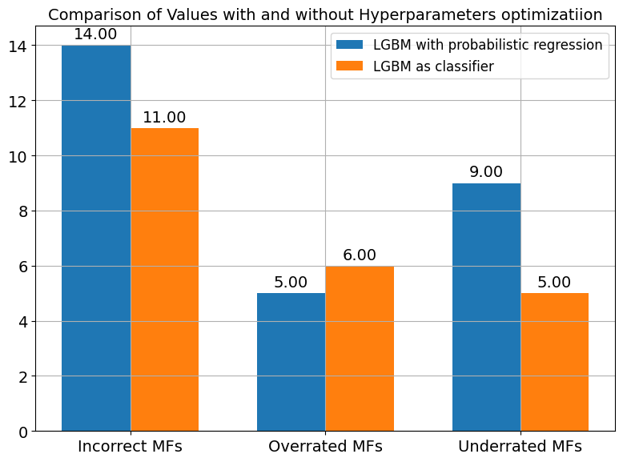
Classifiers vs Quantile Regressor
European
German

Slide 27
Conclusion
For European dataset, we got as a result that using the LGBM with a probabilistic regression of low/high-quantile estimations of SNR produced less incorrectly assigned MFs than when using the LGBM directly as a classifier of MFs.
Nonetheless, both techniques can be seen as having high accuracy (0.94 and 0.93) and valid for use of determining the MF according to path features data.
For German dataset we got a different result from the previous one, as the LGBM with probabilistic regression turned into having 3 more incorrectly-assigned MFs compared to the LGBM as the classifier. Still, both methods of proceeding had a really high accuracy (0.96 and 0.97).
One additional conclusion is that for this dataset the accuracy was higher than the one obtained on the first dataset. This could be attributed to being that we got features of nodes inside a country compared to features of a continent, which give a finer granularity and can allow for a best approximation.

Slide 28
Thanks for your kind attention

